Slide 1

Building Scalable Vertical Integration
Investor Presentation
OTCID: KRTL
www.krtlholding.com

Slide 2
Forward Looking Statements
FORWARD-LOOKING STATEMENTS. This presentation contains forward-looking statements, including statements regarding expected operational performance, regulatory positioning, market opportunities, strategic growth plans, projected cash generation, potential consolidation of subsidiaries, and anticipated future results of KRTL Holding Group Inc. ("KRTL") and its subsidiaries, including KRTL Biotech Inc., SIGMA Corp Bolivia, KRTL International Corp., and related venture structures such as CIQ laboratory integration and the planned Bolivian mint/refinery initiative.
Forward-looking statements are based on current expectations, estimates, forecasts, and assumptions made by management, and on information currently available to KRTL. These statements are not guarantees of future performance. They involve risks and uncertainties, many of which are outside KRTL's control, including (among others): regulatory approvals and registrations; the ability to establish, scale, and maintain production capacity (including GMP/ISO-certified or ISO 17025-certified capabilities); the timing, structure, and enforceability of vertical partnerships; customer adoption and revenue realization; supply chain and logistics execution; geopolitical and jurisdictional risk (including Bolivia); the availability of qualified personnel; access to working capital; and changes in applicable law. Actual results may differ materially from those expressed or implied in any forward-looking statement.
No investor should rely on any forward-looking statement as a prediction of actual results. KRTL undertakes no obligation to update or revise any forward-looking statement to reflect events or circumstances after the date of this presentation.

Slide 3
Company Overview
KRTL Holding Group Inc. (OTC: KRTL) is a U.S.-based public company executing a capital-efficient, vertically integrated growth strategy across biotechnology, international manufacturing, and global trade.
Through its core subsidiaries — KRTL Biotech Inc., SIGMA Corp Bolivia, and KRTL International Corp. — the company develops proprietary health products, controls compliant production, and builds scalable commercialization pathways across regulated and emerging markets.
🔹 Structure Highlights:
Public Reporting Entity — Consolidated GAAP financials with majority control of all subsidiaries
Biotech Leadership — FDA/DEA registered; develops IP-driven pharmaceutical and nutraceutical products
Manufacturing Engine — Owns 99% of SIGMA, a GMP- and ISO-certified manufacturer operating in Bolivia
Global Logistics & Expansion — KRTL International replicates this model into new verticals: critical minerals, certified refining, and cross-border trade
🔹 Strategic Thesis:
KRTL is not just an operator — it is a platform builder, crafting replicable verticals with embedded regulatory, operational, and financial alignment. Each vertical leverages a proven blueprint of R&D, compliant production, and global distribution — fully consolidated under KRTL Holding Inc.
Mission: To build a transparent, cost-efficient, and scalable infrastructure for global health innovation and strategic trade — backed by institutional-grade compliance and public market discipline.
Company Statistics
Stock Symbol
Price
KRTL (OTCID)
$0.1037
Market Cap
Shares Outstanding
$10.2M
96.9 M
Avg Volume
As of
60,000
Oct 29, 2025
Capital Markets Strategy:
As part of its long-term vision, KRTL Holding Group Inc. is actively advancing preparations for a future uplisting to the NASDAQ. This strategic initiative reflects the company’s commitment to transparency, operational discipline, and alignment with institutional investor standards. By strengthening its corporate governance and financial reporting, KRTL aims to access broader capital markets and position itself for sustainable global growth.

Slide 4

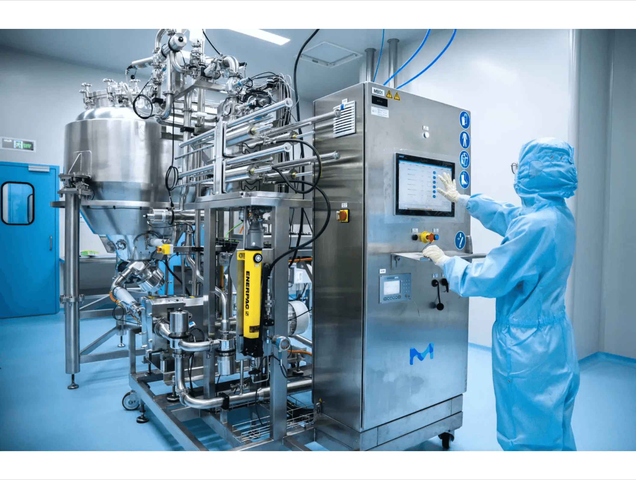
KRTL Biotech Inc.
FDA-Registered Innovation Hub
Ownership Structure
51% KRTL Holding
49% SIGMA Corp Bolivia
KRTL Biotech Inc. serves as the group's FDA-registered biotechnology and pharmaceutical subsidiary, developing proprietary therapeutics, nutraceuticals, and cosmetics while managing U.S. regulatory submissions and commercial strategy.
Core Functions
Product R&D for therapeutics, nutraceuticals, and cosmetics
Regulatory submissions to FDA and DEA
Commercial strategy and market positioning
99% control of SIGMA's GMP/ISO-certified manufacturing capacity
Executed Products
GMP/ISO-Certified Manufacturing Environment
FDA-Registered Formulations
Coca-Lief, ELIXIR, and other proprietary formulations demonstrating seamless regulatory compliance and rapid product development

Slide 5

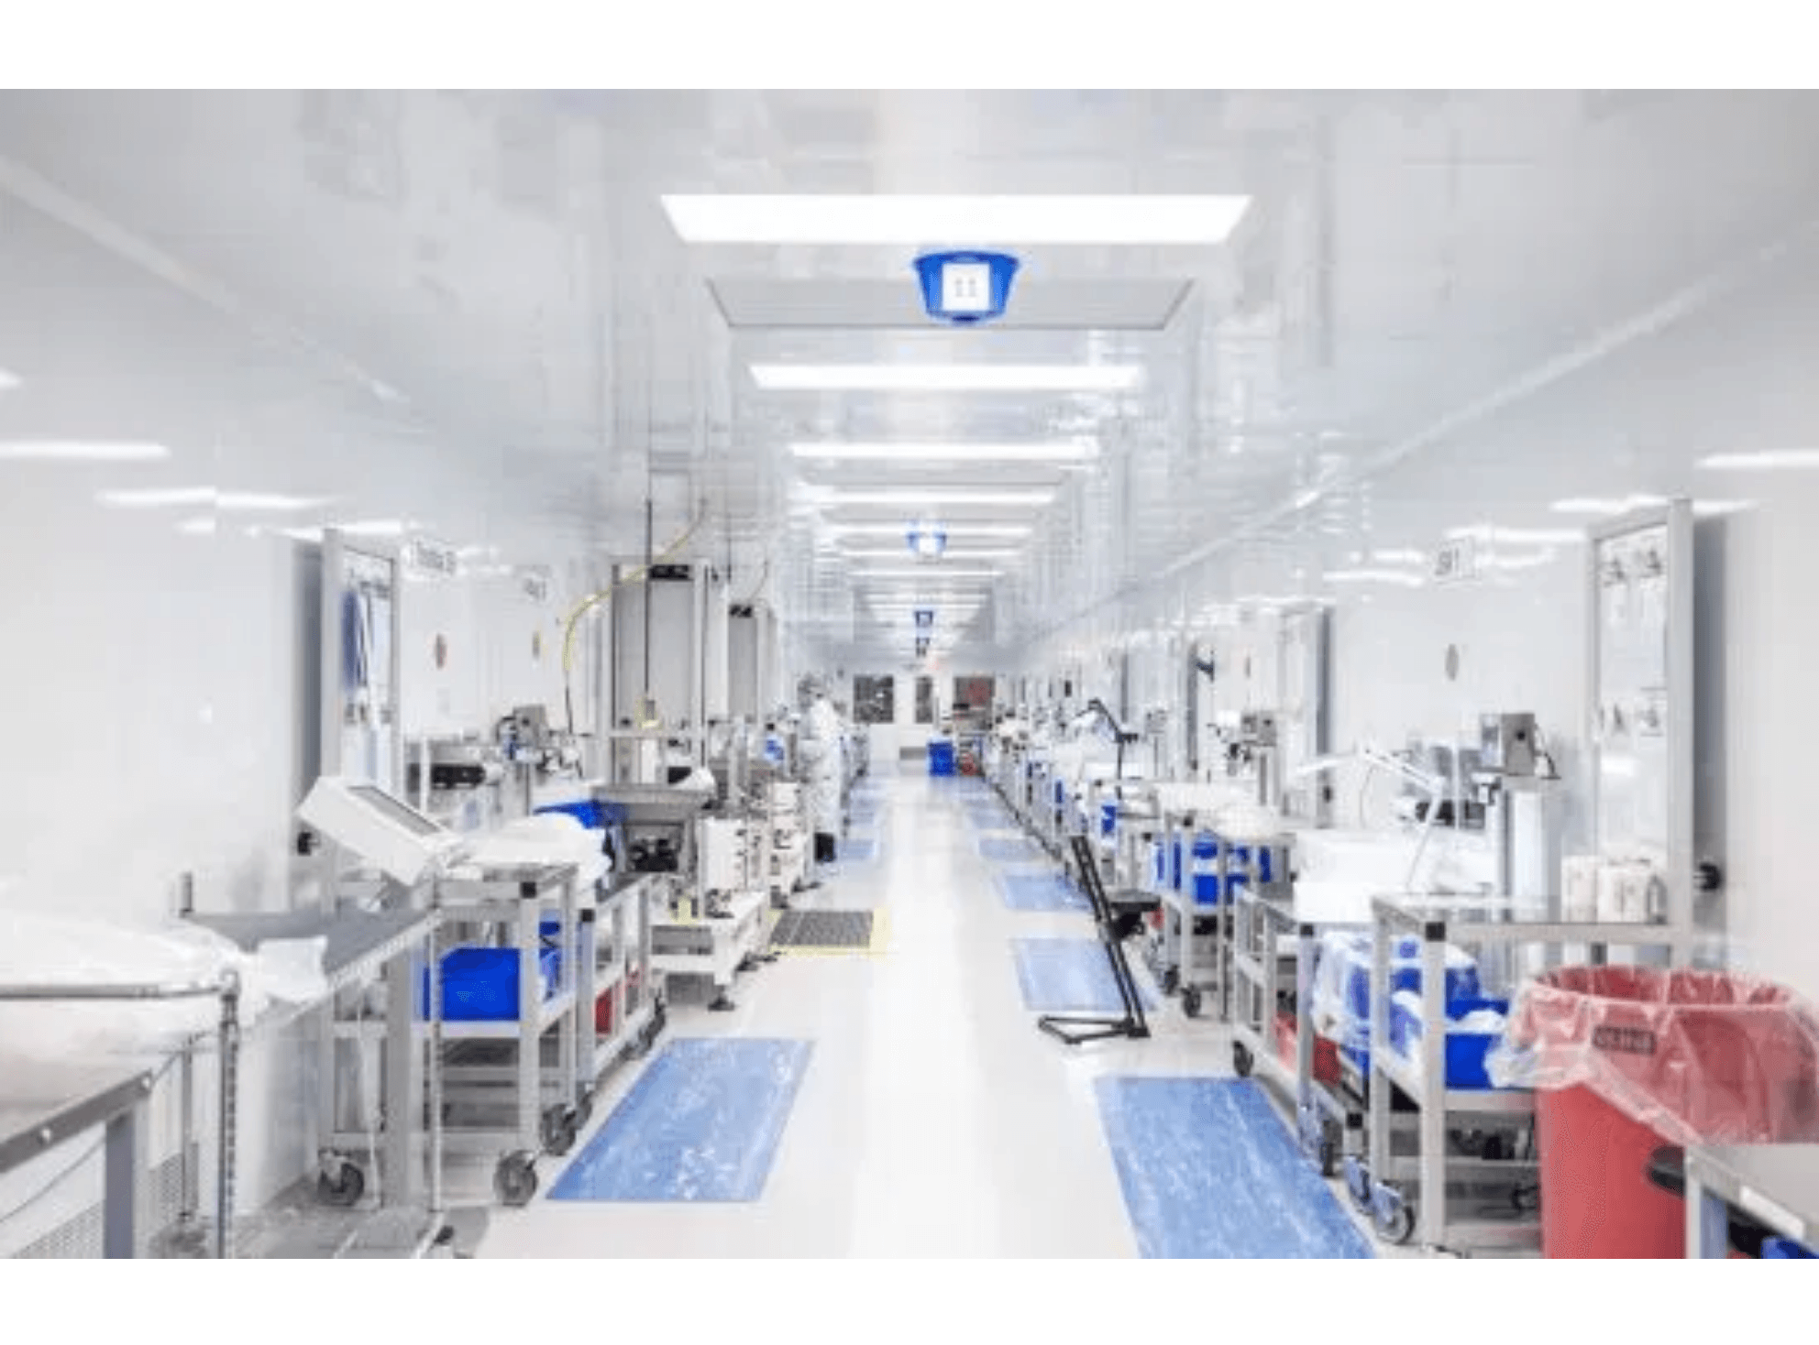
Biotech Impact & Consolidation
Seamless Execution: Rapid Development Meets Compliance
2025 Merger Overview
GMP-Certified Manufacturing
The KRTL Biotech and SIGMA Corp merger executed in September of 2025, created a vertically integrated pharmaceutical structure that provides end-to-end oversight from product development through GMP-compliant manufacturing.
Key Metrics
Current Capacity
40%
Substantial headroom for expansion without additional capital investment
SIGMA Revenue
$19.7 Million
Sales for the six months ended September 30, 2025, with potential to double within two years
KRTL Ownership
99%
SIGMA's ISO and GMP-certified facilities provide pharmaceutical-grade production capabilities with significant expansion capacity
Control of SIGMA manufacturing capacity through Biotech subsidiary

Slide 6

Vertical Integration: Four Critical Components
01
02
Regulatory Oversight
Certified Manufacturing Based in Latin America
FDA compliance ensuring product safety and market access. Manages all regulatory submissions and maintains certification standards across U.S. and international markets.
GMP/ISO-certified production capabilities for scalable output. Provides pharmaceutical-grade manufacturing infrastructure with capacity for expansion across multiple product lines.
03
04
Global Logistics
Scientific Depth
Cross-border distribution and export management infrastructure. Enables seamless product movement across international markets with full supply chain transparency and control.
Specialized expertise in product development and quality control. Combines research capabilities with analytical precision to ensure product efficacy and compliance throughout the development cycle.
Merger Model Overview- Vertically Integrated
KRTL's vertical integration model combines regulatory oversight, certified manufacturing, global logistics, and scientific expertise to ensure rapid development, compliance, and scalability. This integrated approach is replicable across high-impact verticals including biotech, clean energy minerals, and pharmaceutical-grade commodities.

Slide 7


KRTL International Corp. — Strategic Expansion Platform
Logistics & Strategic Ventures
100% KRTL HOLDING
Core Functions
Current Initiatives
Strategic Mission
U.S. government licensed (TTB-approved) for alcohol import and wholesale distribution
KRTL International is currently spearheading a Joint Venture with CIQ (Centro de Investigaciones Químicas), a scientific leader with multimillion-dollar operations in Bolivia. This Joint Venture includes the development of two new R&D and compliance facilities, jointly owned and operated with CIQ, aimed at scaling certified pharmaceutical and mineral testing capabilities across Latin America. As part of future strategic alignment, CIQ is also positioned for potential acquisition into KRTL.
KRTL International Corp. is the global expansion and trade subsidiary of KRTL Holding Group. It extends the vertically integrated model proven by KRTL Biotech and SIGMA into new sectors including certified mineral processing, international logistics, and cross-border consumer goods.
Strategic partnerships with CIQ Labs (ISO 17025 accreditation expansion) and the Bolivian Mint (modular refinery development)
Management and consulting services
With 100% ownership under KRTL Holding, the subsidiary acts as both a consulting compliance gateway and commercialization engine, enabling KRTL to create strategic partnerships and joint ventures across Latin America and North America.
Joint venture structuring for strategic partnerships
Exclusive rights to premium Bolivian brands (Huella, Anzeztro)
All assets and operational performance are consolidated to KRTL Holding for US GAAP reporting.

Slide 8

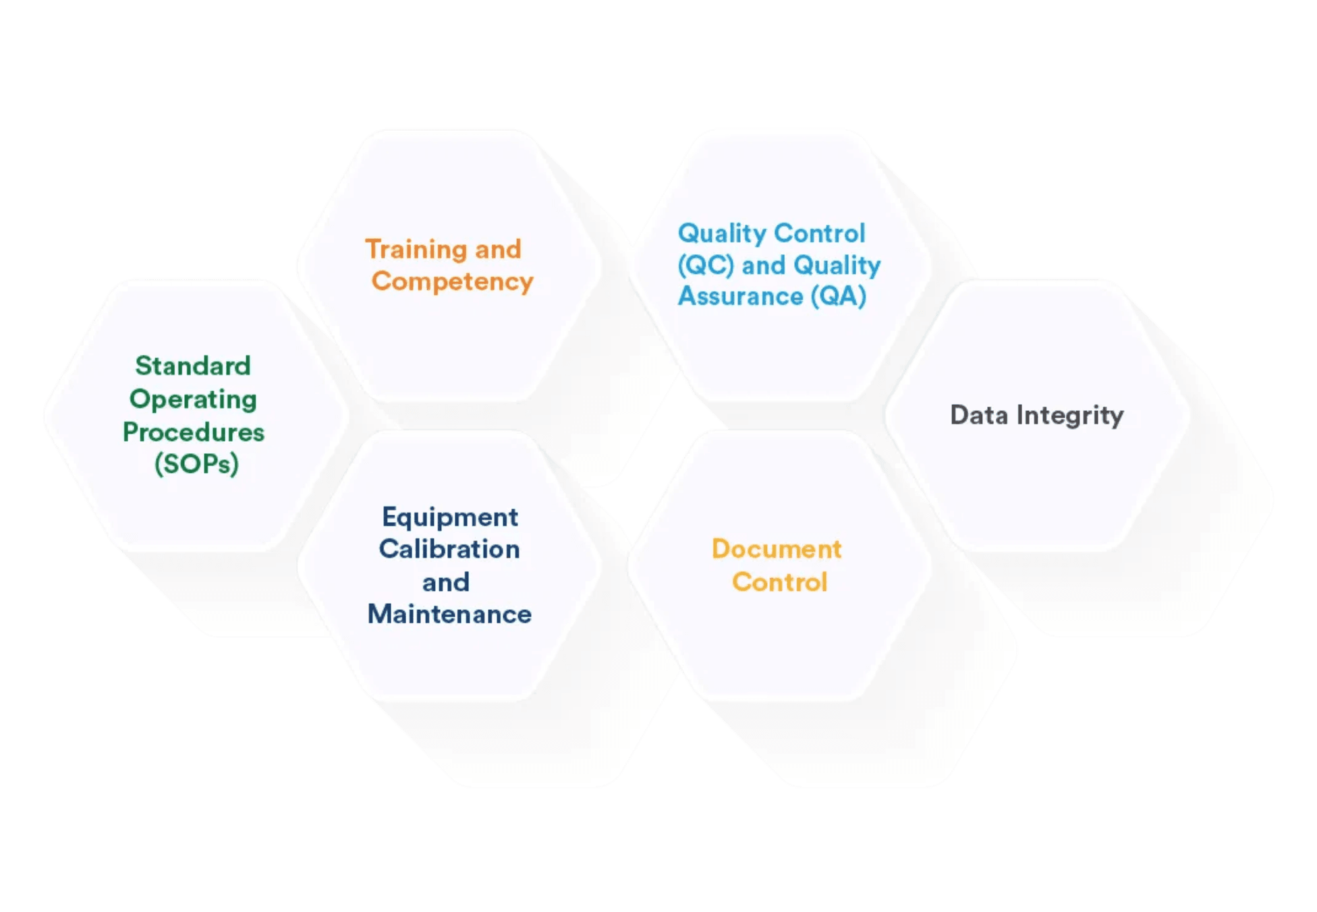
CIQ Labs — Precision Certification
Partnership Overview
Quality Assurance Framework
KRTL International is partnering with CIQ Laboratories to expand ISO 17025 accreditation scope for critical minerals. This initiative establishes KRTL's analytical backbone for new vertical markets in clean energy and precious metals.
Critical Minerals Coverage
Lithium
Cobalt
Rare Earths
Gold
Platinum
Others
Advanced Analytical Methods
ICP-MS (Inductively Coupled Plasma Mass Spectrometry)
XRF (X-Ray Fluorescence)
Fire Assay Techniques
Replicating the Vertical Model
CIQ Labs is structured under KRTL International for consolidated growth and provides the regulatory infrastructure component of the vertical integration model, combining analytical capabilities with scientific leadership and production readiness.
Strategic Focus
ESG traceability and metal certification, meeting growing demand for transparent and sustainable supply chains.

Slide 9

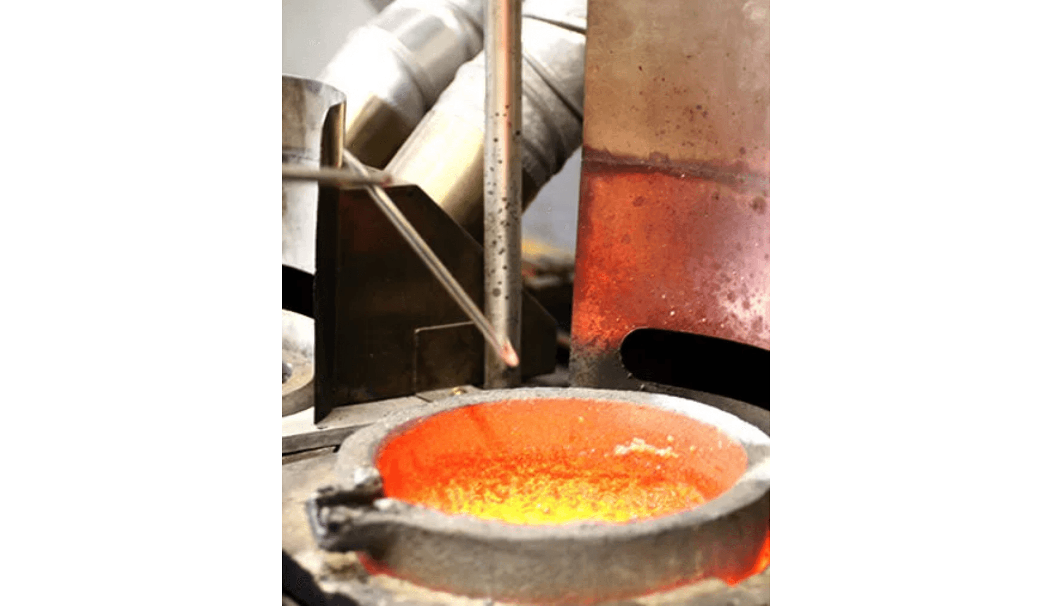
Bolivian Mint — High-Output Refining
Project Overview
Refining Process
The Bolivian Mint project establishes a modular refinery for precious metals, integrating CIQ laboratory capabilities with blockchain traceability for transparent and certified metal refining.
Refining Capabilities
Gold
Silver
Antimony
Palladium
Key Features
Modular processing for multiple precious metals
Integrated quality control through CIQ labs
Blockchain traceability for ESG compliance
Modular refinery operations for high-purity precious metal production
Transparent supply chain verification
Replicating the Biotech-SIGMA Structure
The Bolivian Mint combines CIQ infrastructure for analytical services, Dr. Bascope's scientific leadership, and Industrial Park production and export capabilities—mirroring the proven vertical integration model.
Forecasted Monthly Output
$1.5M
In refined products, demonstrating significant revenue potential and scalability

Slide 10
Consolidated Ownership & Strategic Vision
Ownership Snapshot: Control, Compliance, Scale
Subsidiary
Ownership
Function
Status
FDA/DEA Regulatory, Product Development
KRTL Biotech Inc.
51%
Owned by KRTL Holding
Operational
GMP/ISO Manufacturing
SIGMA Corp Bolivia
99%
Owned by KRTL Biotech (Sept 2025)
Operational
Owned by KRTL Holding
Global Logistics, Consulting, JVs
KRTL International Corp
100%
Expanding
To be structured under KRTL International
Lab Accreditation & Metal Refining
CIQ + Refinery Partners
In Progress
Strategic Vision
KRTL maintains majority ownership, financial control, and compliance leadership across all operations. The company's proven model of combining regulatory oversight, certified manufacturing, global logistics, and scientific depth is positioned to scale across multiple high-impact verticals.
Vertical by vertical, KRTL is building a replicable blueprint for global investment in biotech, clean energy minerals, and pharmaceutical-grade commodities.

Slide 11


Investment Summary
Demonstrated Success
KRTL Holding Group has demonstrated its vertical integration model through the successful Biotech-SIGMA merger. The company plans to scale this proven model through KRTL International with CIQ Labs and the Bolivian Mint project.
Scalability
Proven vertical integration model replicable across high-impact sectors
Transparency
Consolidated financial reporting under U.S. GAAP standards
Vertical Expansion
End-to-end control in biotech, minerals, and pharmaceutical sectors
Upcoming Catalysts
01
02
03
Initiation of consolidated revenue reporting expected to reflect November 15, 2025
Expansion of FDA consulting services and cross-border product distribution
Implementation of growth strategy to scale SIGMA's Bolivian production for global pharmaceutical exports

Slide 12
Contact Us
14143 Denver West Pkwy, Suite 100
Lakewood, CO 80401
(855) KRTL-HLD
Investor Presentation
OTC: KRTL
www.krtlholding.com

